Slide 1
Creating Dynamic
Web Sites
PHP & MySQL for Dynamic Web Sites

Slide 2
What You Will Learn
Including Multiple Files
Handling HTML Forms, Revisited
Making Sticky Forms
Creating Your Own Functions

Slide 3

Including Multiple Files
Divide your scripts and websites into distinct parts, each part being stored in its own files.
Separate commonly used processes.
header
header.php
body
footer
footer.php

Slide 4
Including Multiple Files
include(“header.php”);
include() //warning
include_once()
require() //fatal
require_once()
header
header.php
body
footer
include(“footer.php”);
footer.php

Slide 5
Absolute vs Relative Path
Absolute Path: Location in a file system relative to the root directory
Relative Path: Location in a file system relative to the current directory you are working on

Slide 6



Absolute vs Relative Path
Lucy
Where’s Lucy’s house?
9 York Street, Dagon Tsp
2 houses on your right.

Slide 7
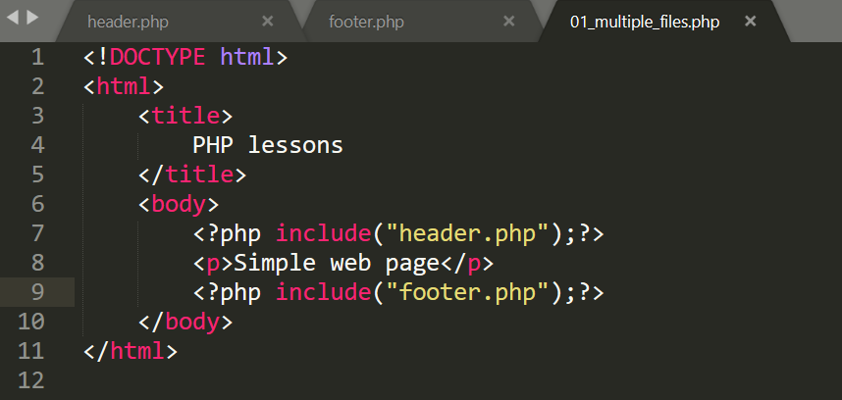
Example Code

Slide 8
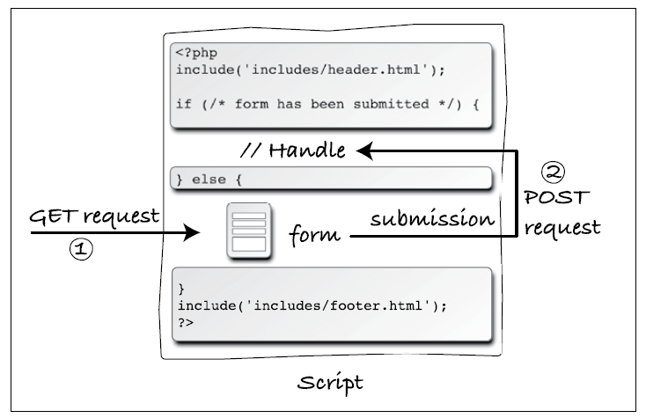
Handling HTML Form: Revisited

Slide 9
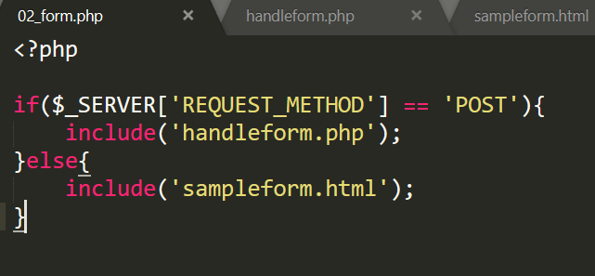
Example Code

Slide 10
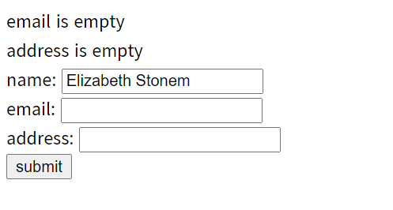
Sticky Forms
Simply a standard HTML form which remembers your previously filled data

Slide 11
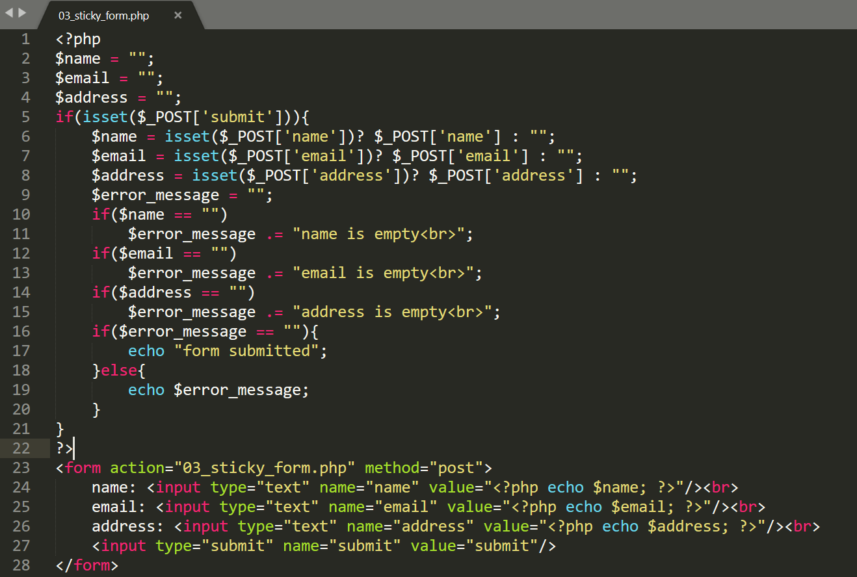
Sticky Form: Sample Code

Slide 12
Creating Your Own Function
A function is a block of statements that can be used repeatedly in a program.
A function will not execute automatically when a page loads.
A function will be executed by a call to the function.
A function takes one more input in the form of parameter and does some processing and returns a value
Built-in Functions or User Defined Functions
ax + ay = a ( x+y)

Slide 13
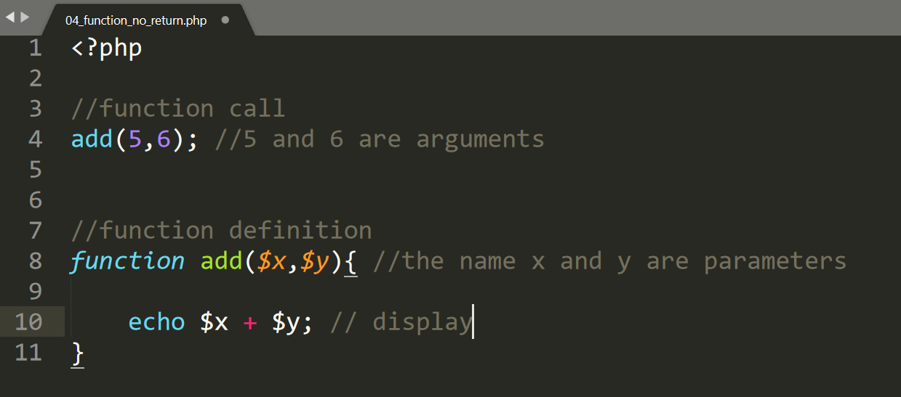
Function Without Return Value

Slide 14
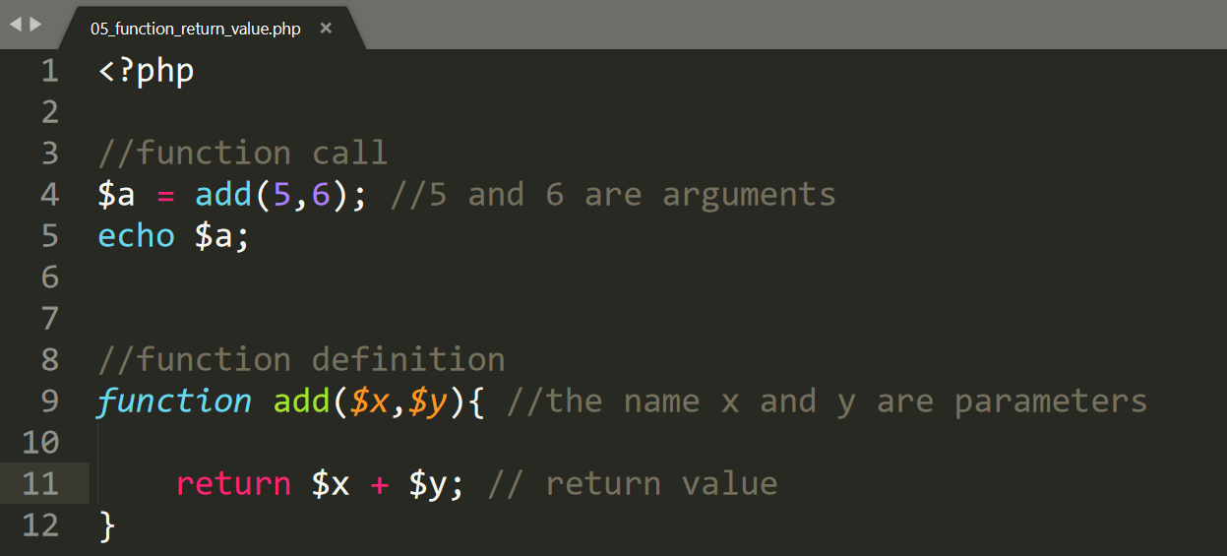
Function With Return Value

Slide 15
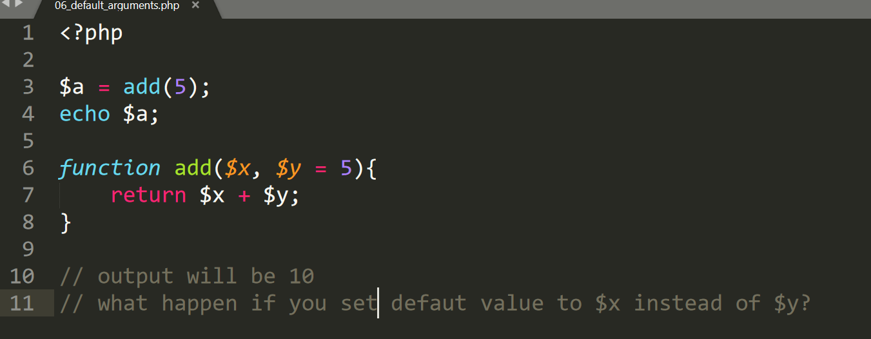
Default Arguments

Slide 16
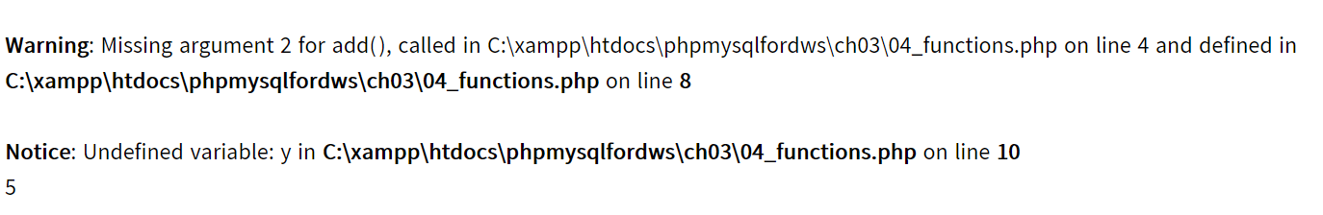
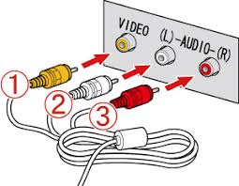
Missing Arguments

Slide 17
Variable Scope
Local: The variables declared within a function are called local variables to that function and has its scope only in that particular function.
Global: The variables declared outside a function are called global variables. These variables can be accessed directly outside a function.

Slide 18
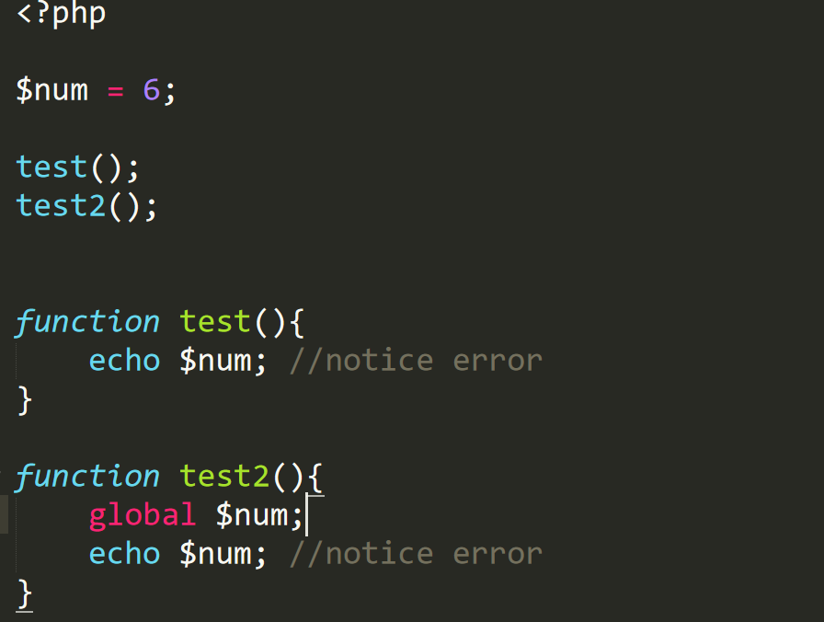
Variable Scope: Example

